Slide 1



WELCOME
IN498 – Capstone in Analytics
UPDATED: JUNE 20, 2018

Slide 2

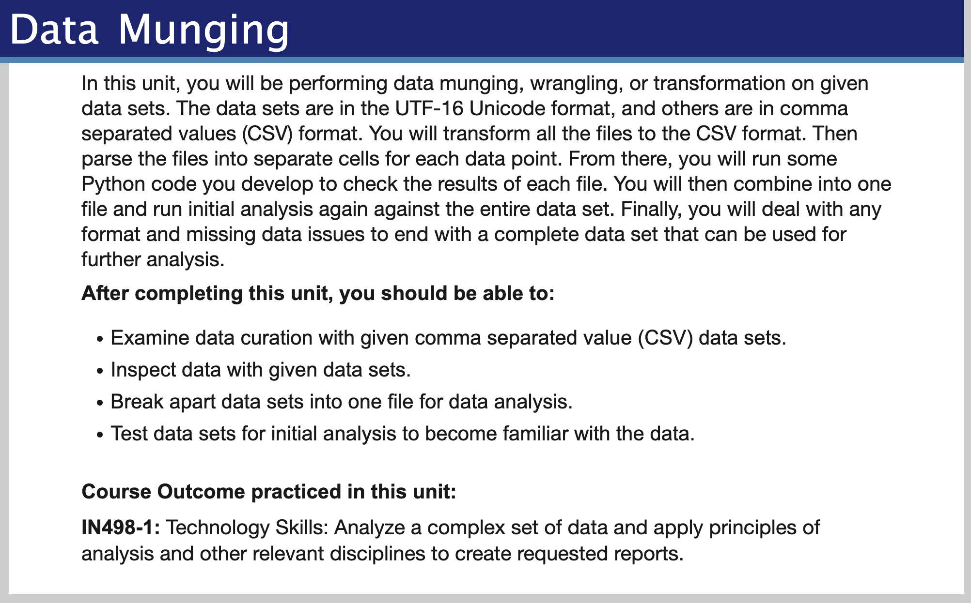
Overview
Purdue University Global |Foundations of Purdue Global Culture

Slide 3
Unit 2
Be sure to review Unit 2 in Brightspace for more details
Reading
-- See next slide
Discussion Question (20 points)
-- See following slides.
Assignment (60 points)
-- See following slides.
Seminar (20 points)
-- Option 1: Attend each week.
-- Option 2: Reflective Assignment.
Purdue University Global |Foundations of Purdue Global Culture

Slide 4
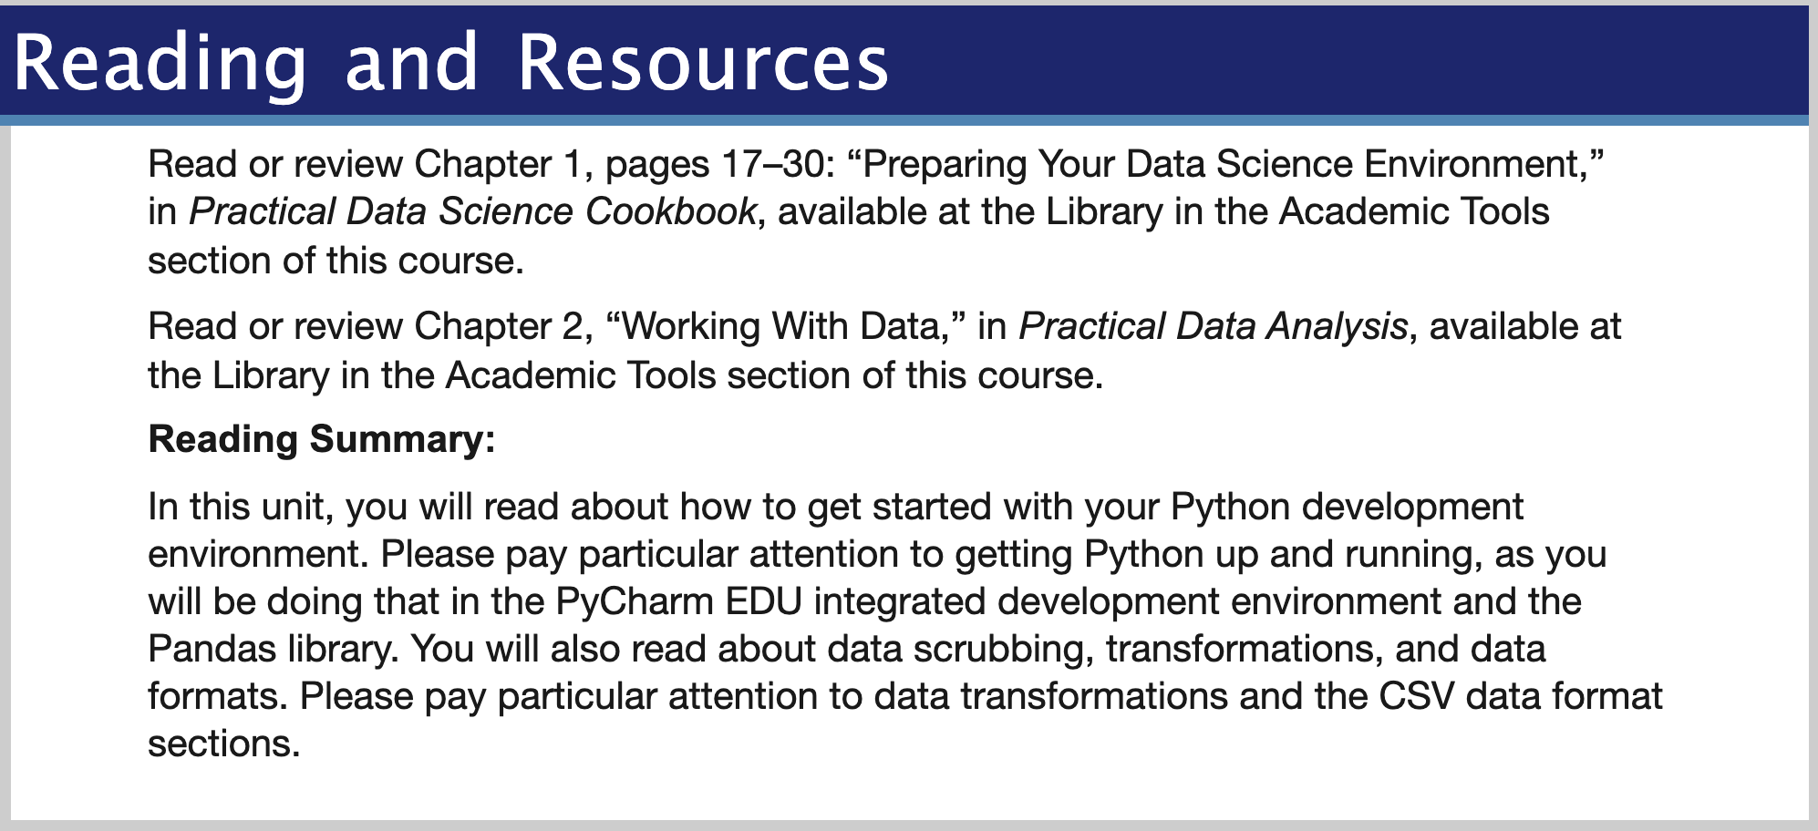
Reading
Purdue University Global |Foundations of Purdue Global Culture

Slide 5
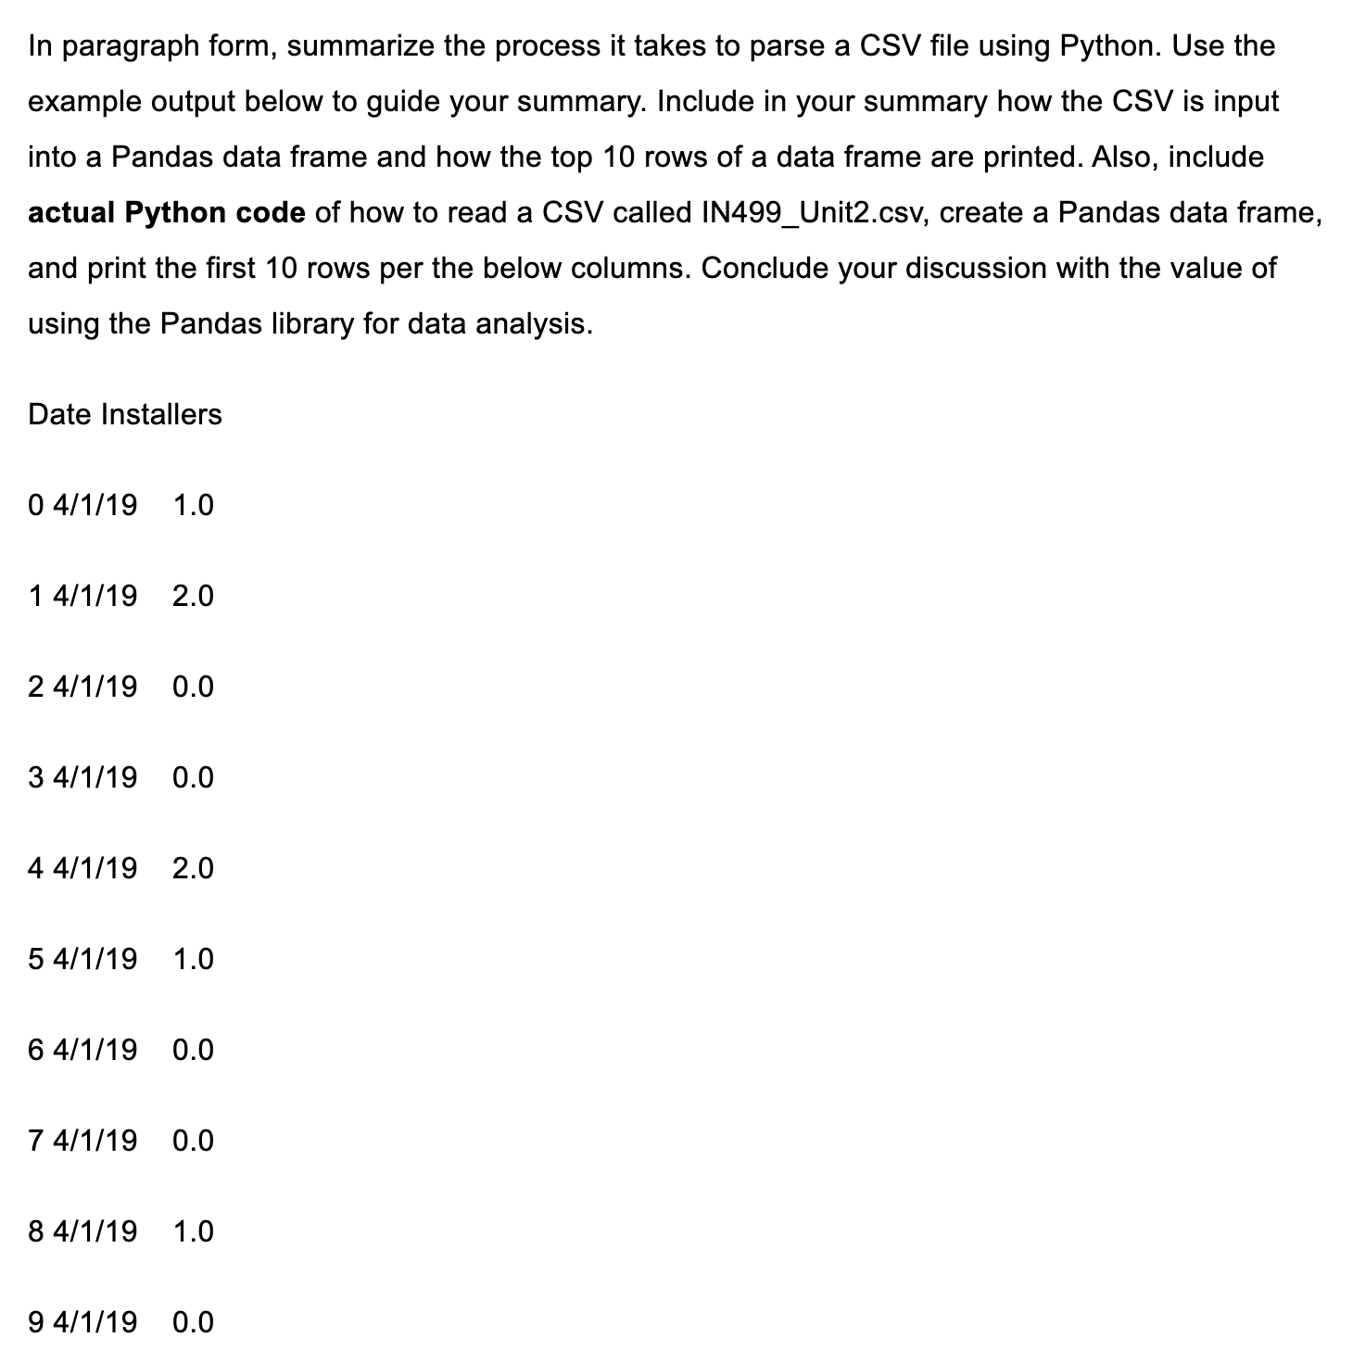
Discussion
Purdue University Global |Foundations of Purdue Global Culture

Slide 6
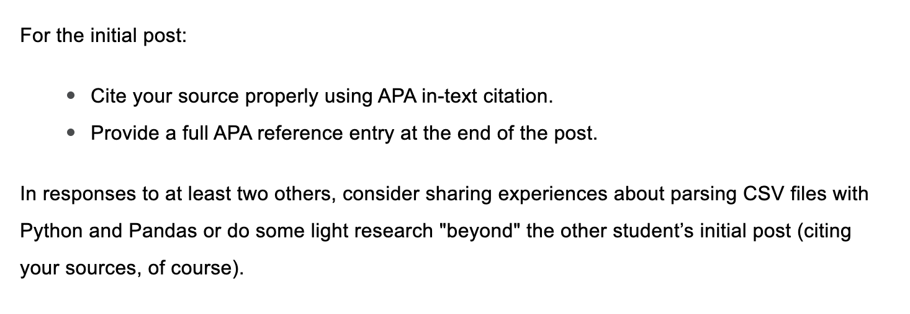
Discussion
Purdue University Global |Foundations of Purdue Global Culture

Slide 7
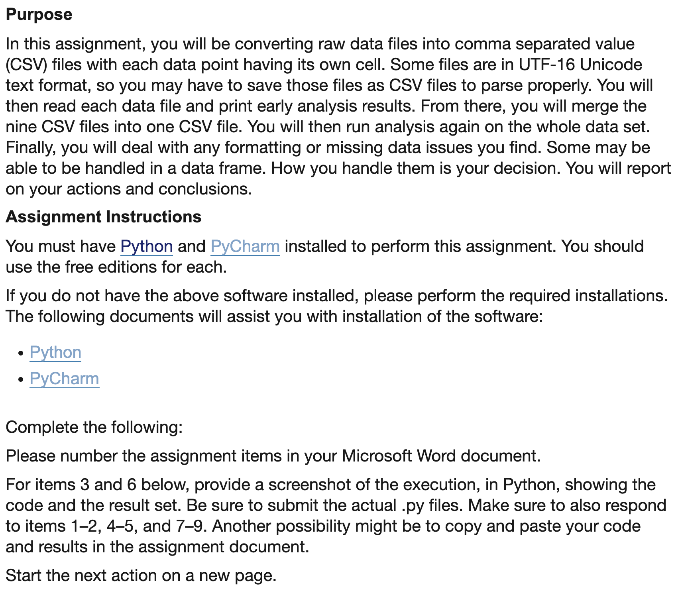
Assignment
Purdue University Global |Foundations of Purdue Global Culture

Slide 8
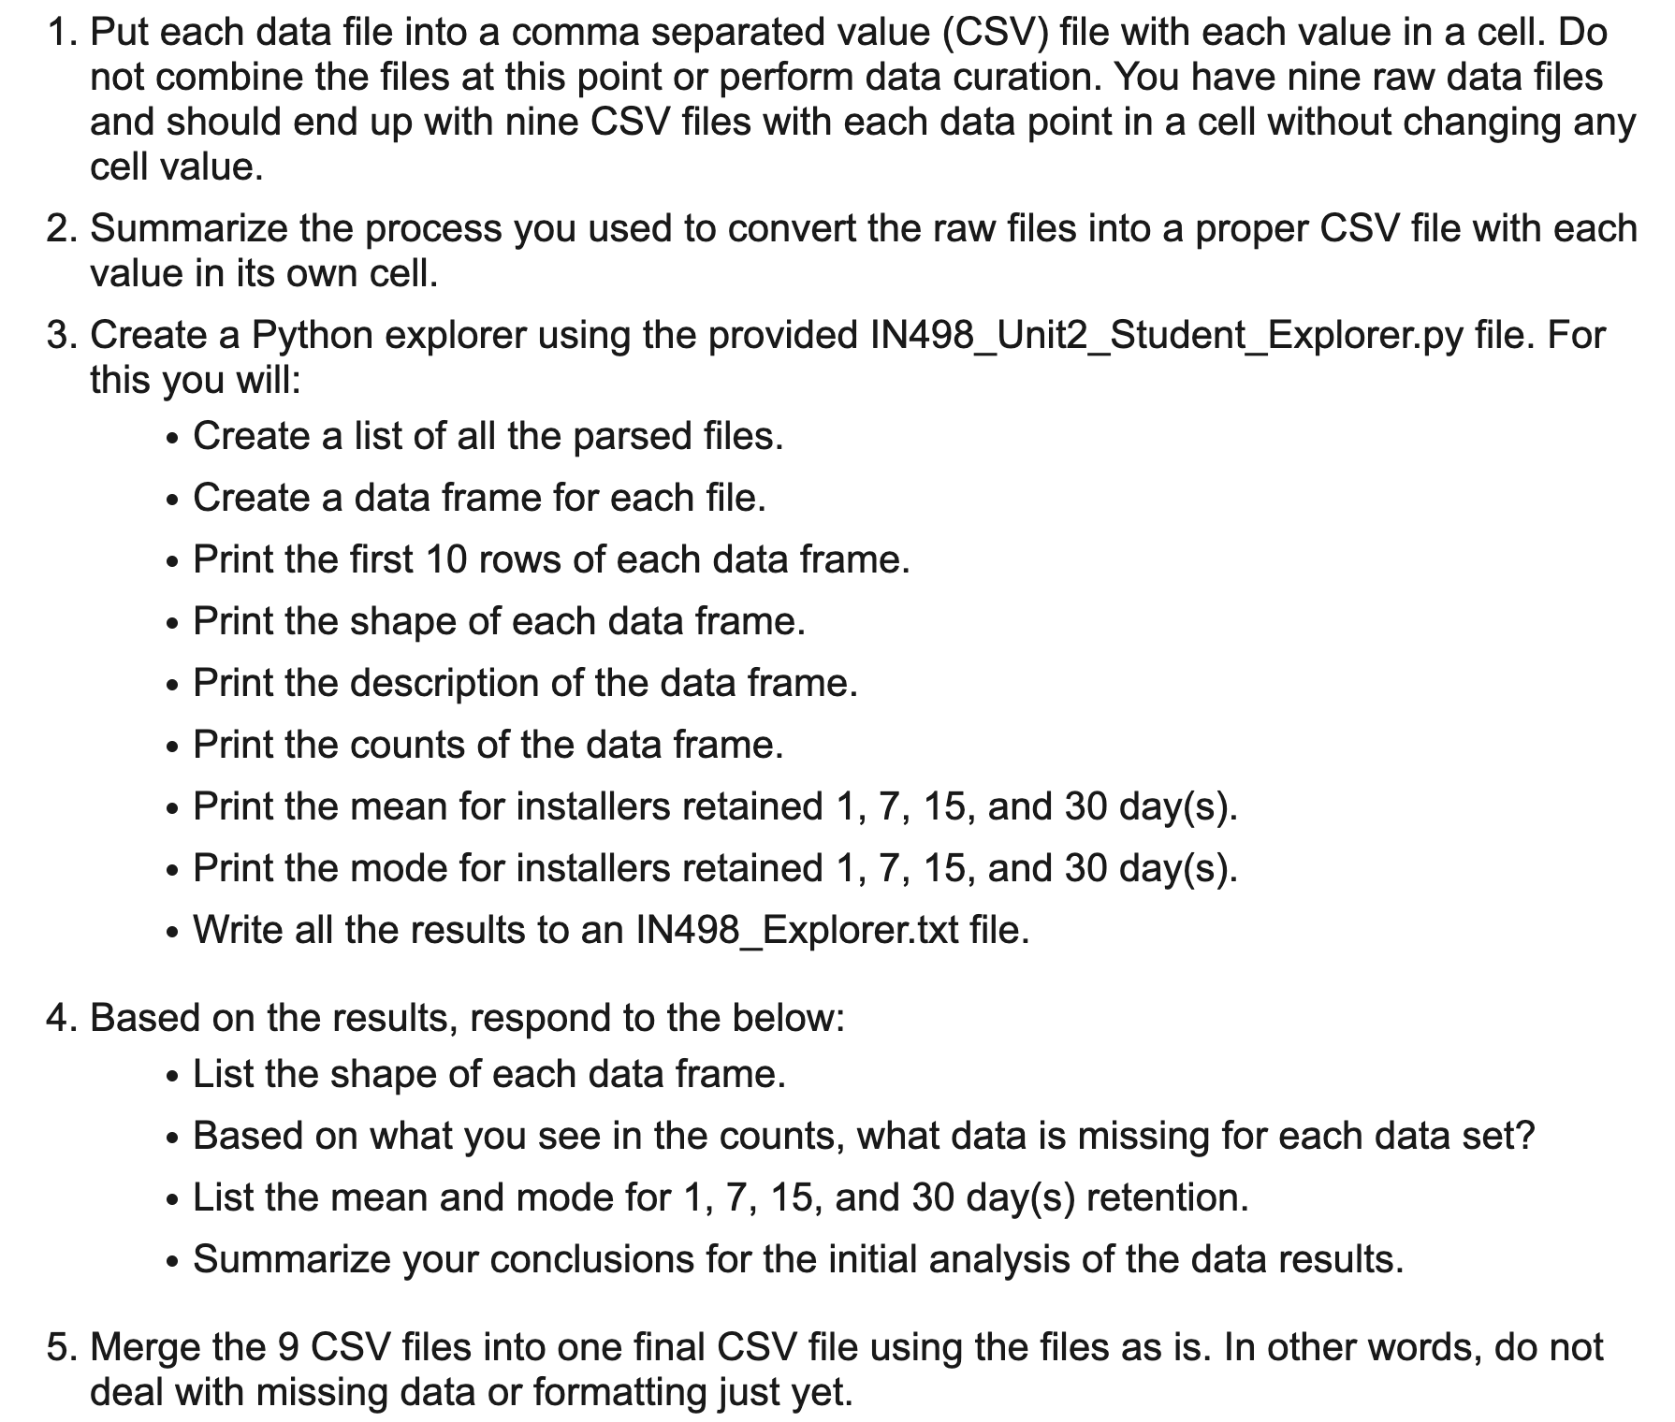
Assignment
Purdue University Global |Foundations of Purdue Global Culture

Slide 9
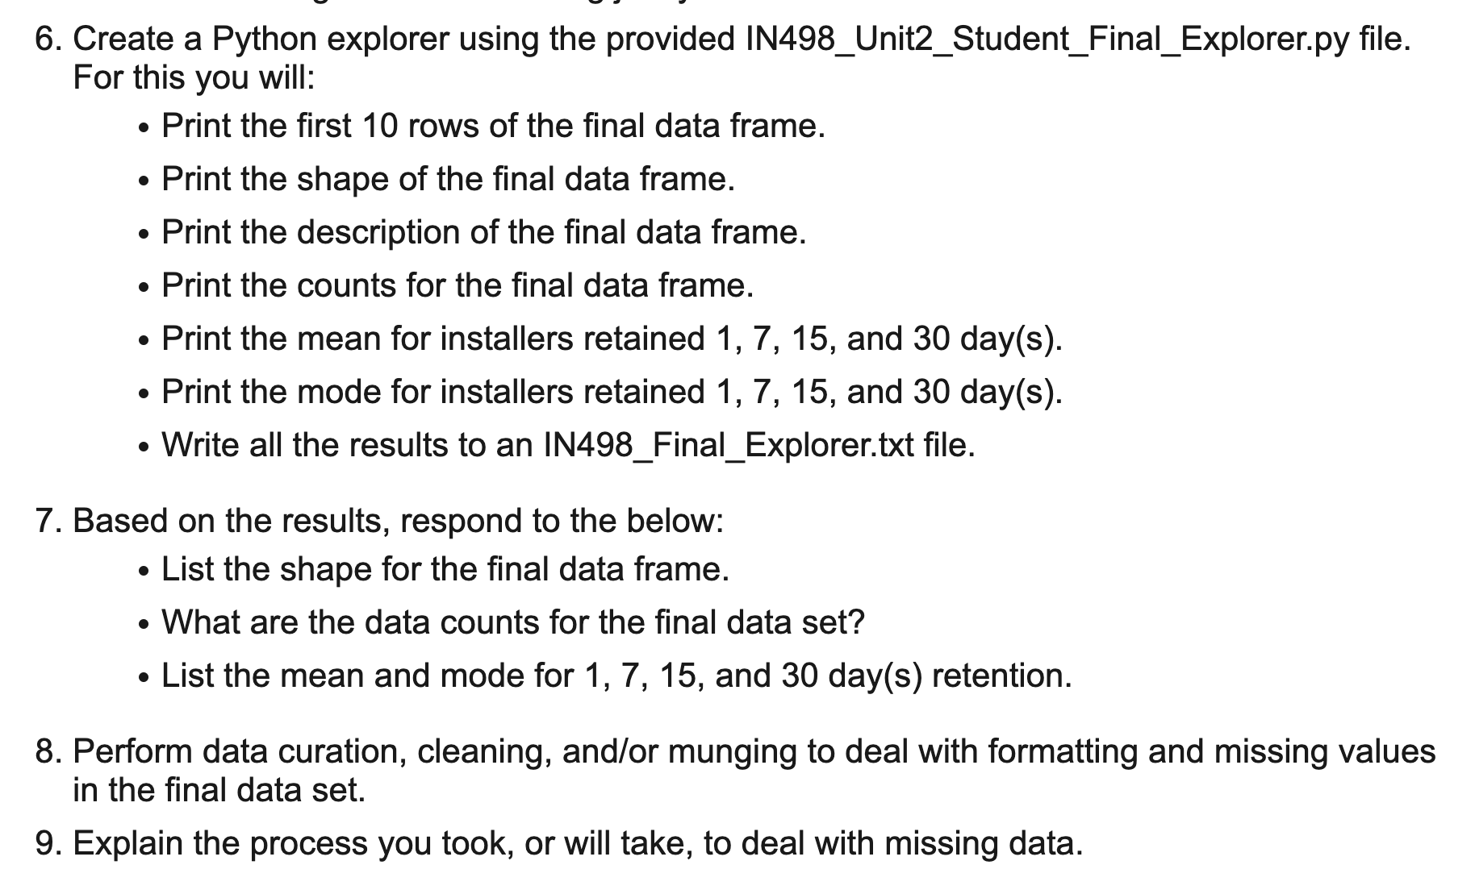
Assignment
Purdue University Global |Foundations of Purdue Global Culture

Slide 10
Unit 2

Slide 11
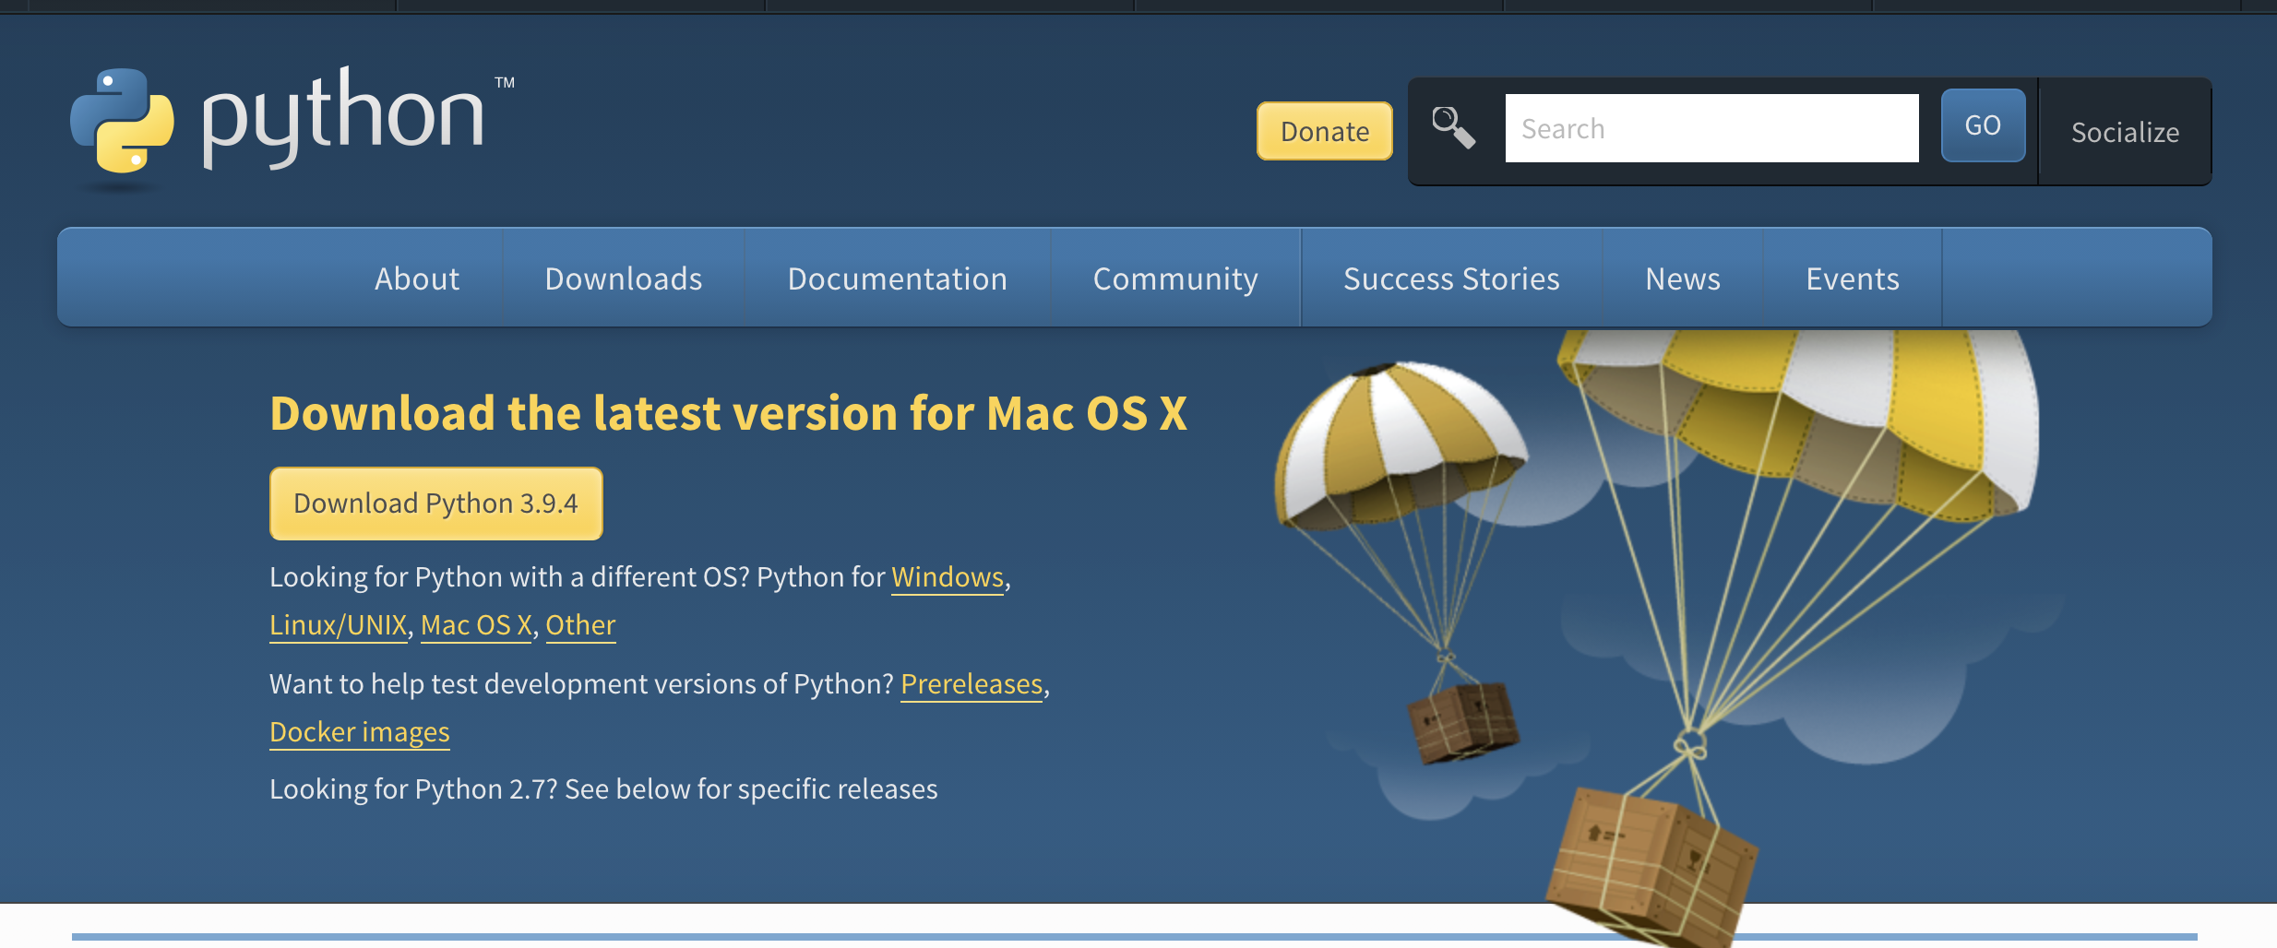

Python Download
Purdue University Global |Foundations of Purdue Global Culture
Notes:
https://www.python.org/downloads/

Slide 12

PyCharms EDU
Purdue University Global |Foundations of Purdue Global Culture
Notes:
https://www.jetbrains.com/pycharm-edu/

Slide 13
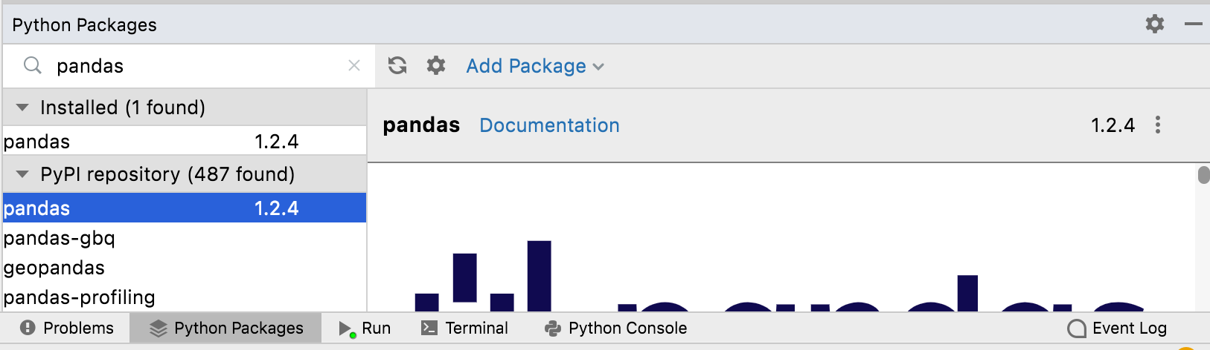
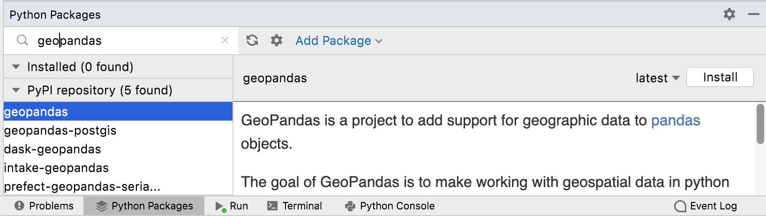
PyCharms EDU
Purdue University Global |Foundations of Purdue Global Culture
Notes:
https://www.jetbrains.com/pycharm-edu/

Slide 14
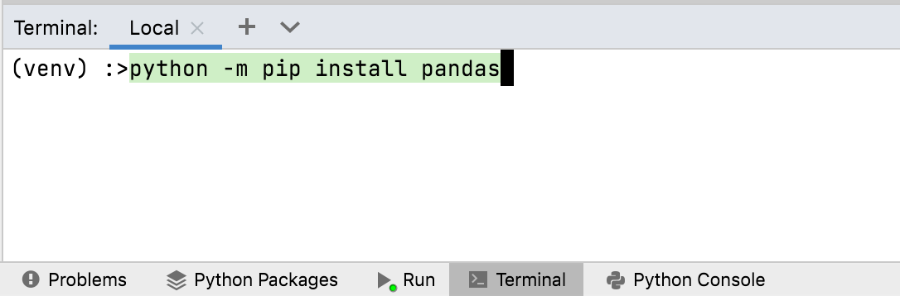
PyCharms EDU
Purdue University Global |Foundations of Purdue Global Culture
Notes:
https://www.jetbrains.com/pycharm-edu/

Slide 15
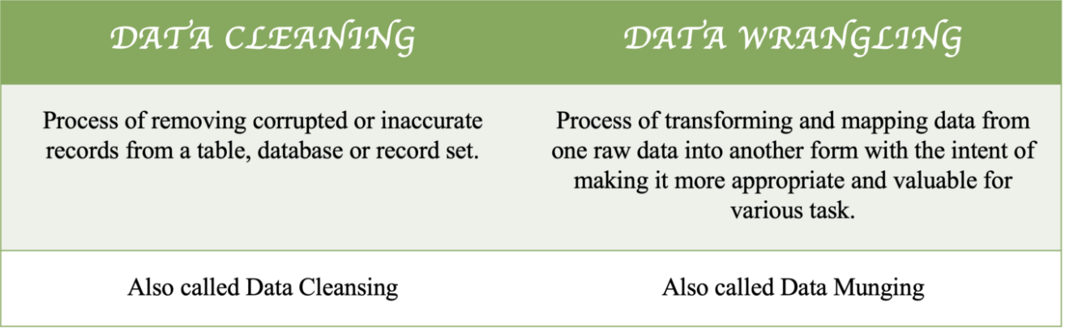
Data Cleaning versus Data Munging
Purdue University Global |Foundations of Purdue Global Culture
Notes:
https://medium.com/dev-genius/data-cleaning-vs-data-wrangling-3577827e28a7

Slide 16
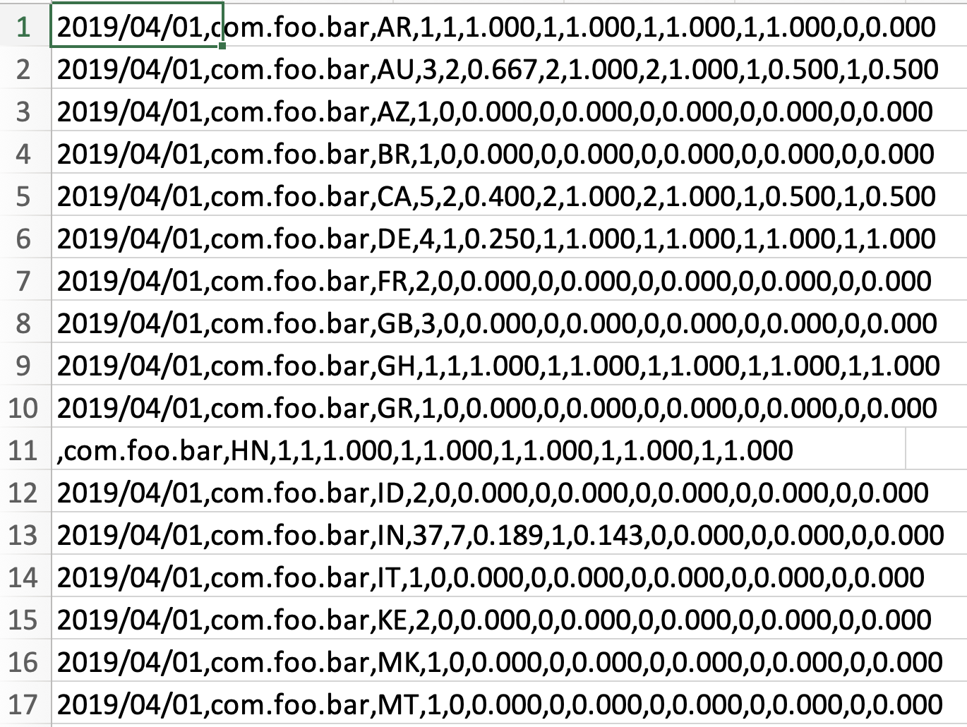
Original CSV
Purdue University Global |Foundations of Purdue Global Culture

Slide 17
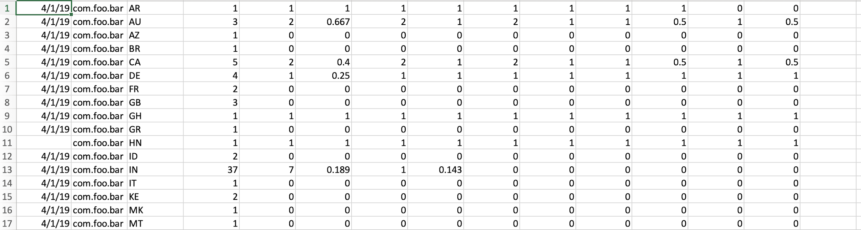
Cleaned and Munged CSV
Purdue University Global |Foundations of Purdue Global Culture

Slide 18
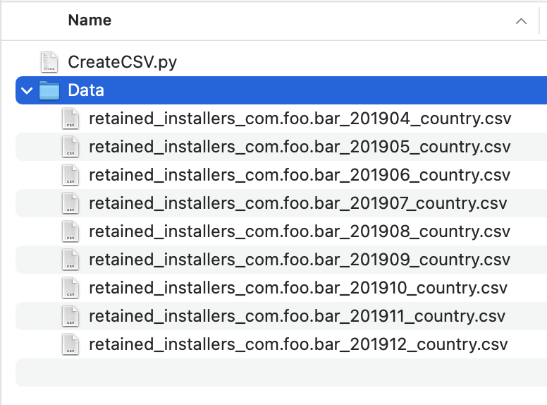
Code to Convert
Purdue University Global |Foundations of Purdue Global Culture

Slide 19
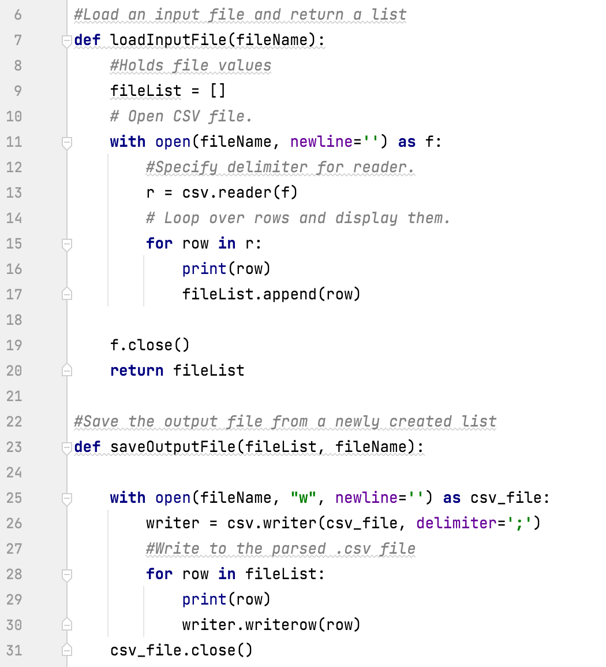
Code to Convert
Purdue University Global |Foundations of Purdue Global Culture

Slide 20
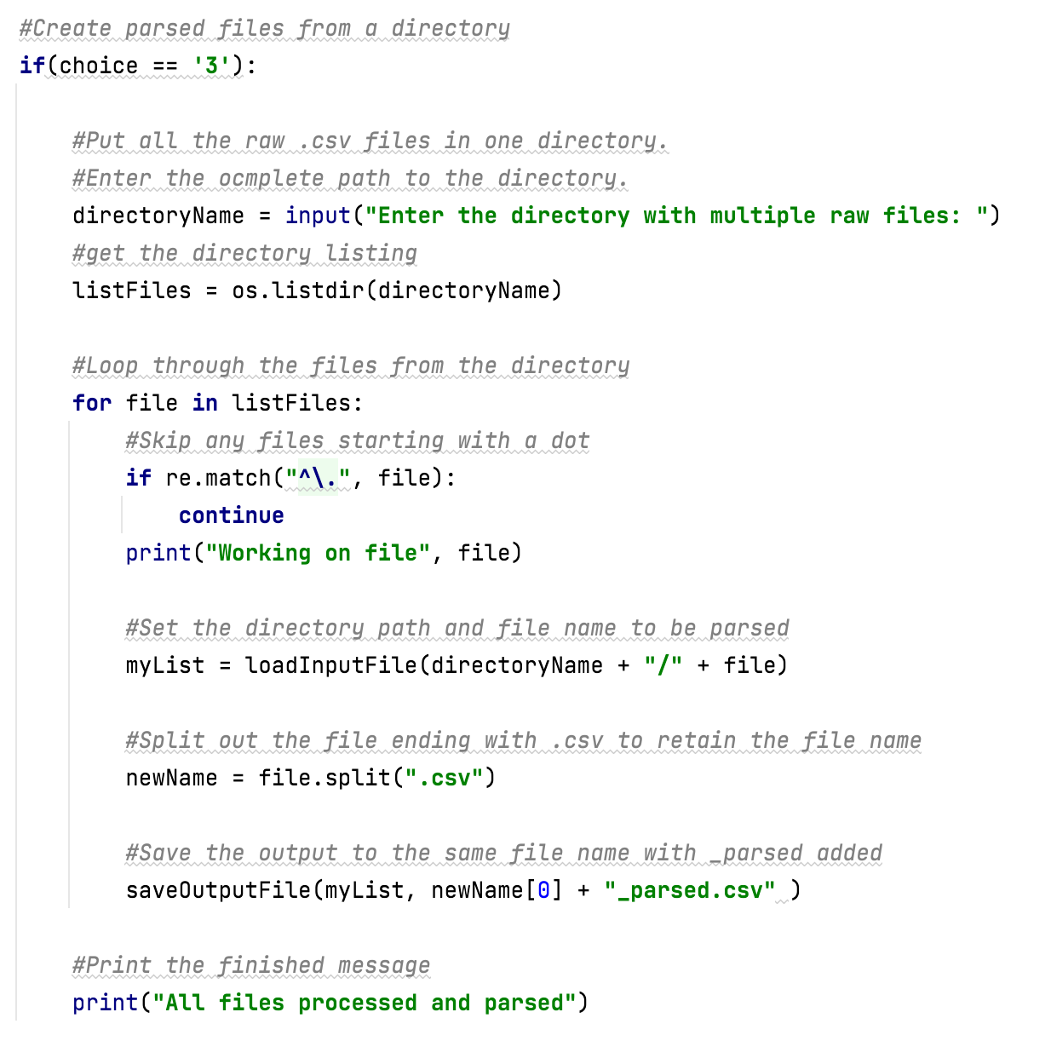
Code to Convert
Purdue University Global |Foundations of Purdue Global Culture

Slide 21
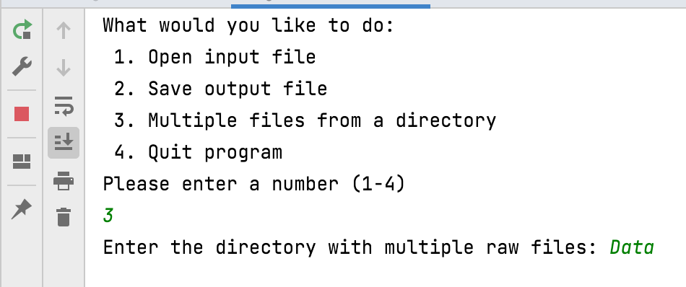
Code to Convert
Purdue University Global |Foundations of Purdue Global Culture

Slide 22
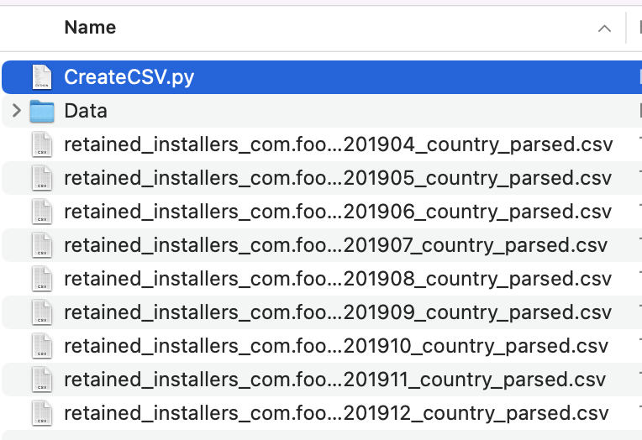
Code to Convert
Purdue University Global |Foundations of Purdue Global Culture

Slide 23
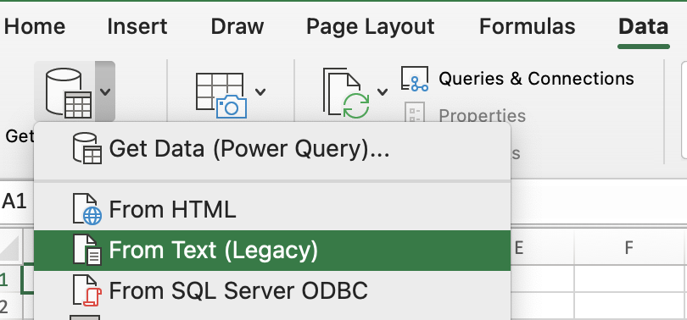
Excel to Convert
Purdue University Global |Foundations of Purdue Global Culture

Slide 24
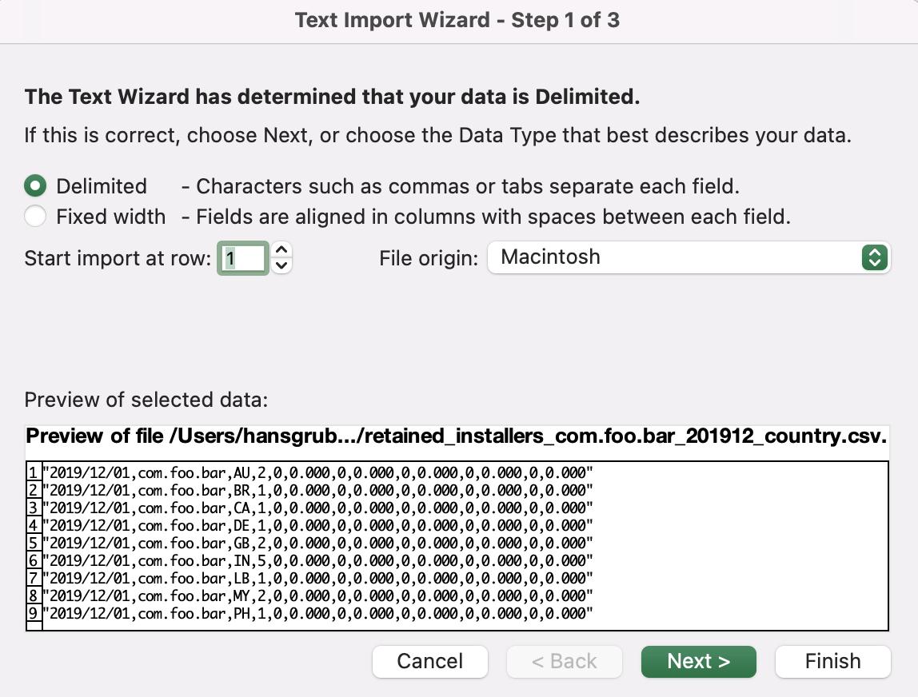
Excel to Convert
Purdue University Global |Foundations of Purdue Global Culture

Slide 25
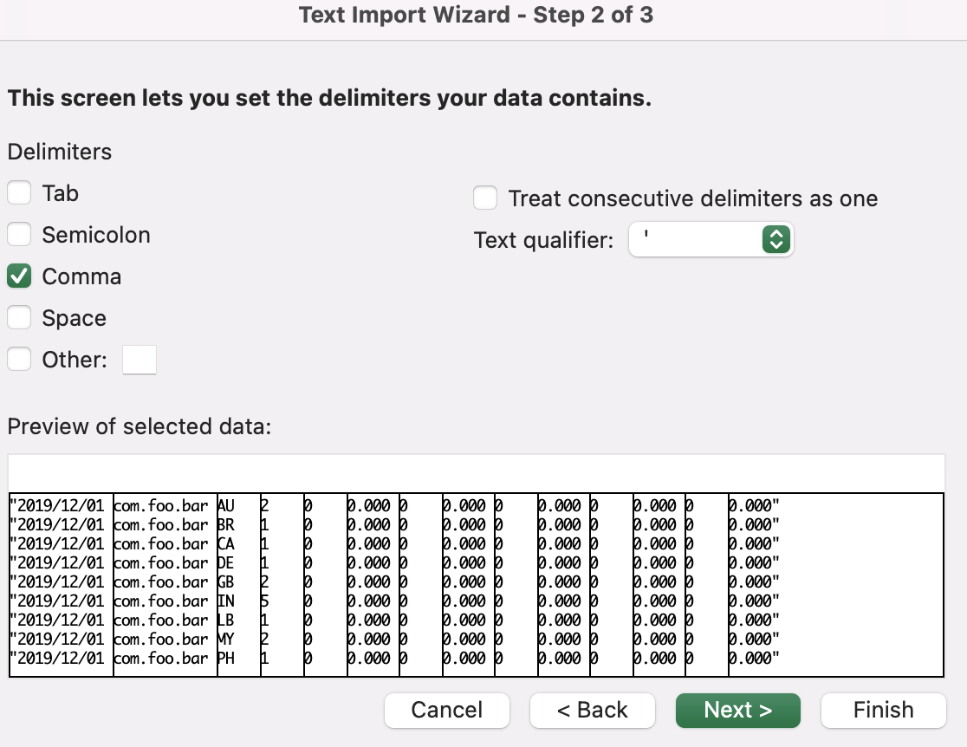
Excel to Convert
Purdue University Global |Foundations of Purdue Global Culture

Slide 26
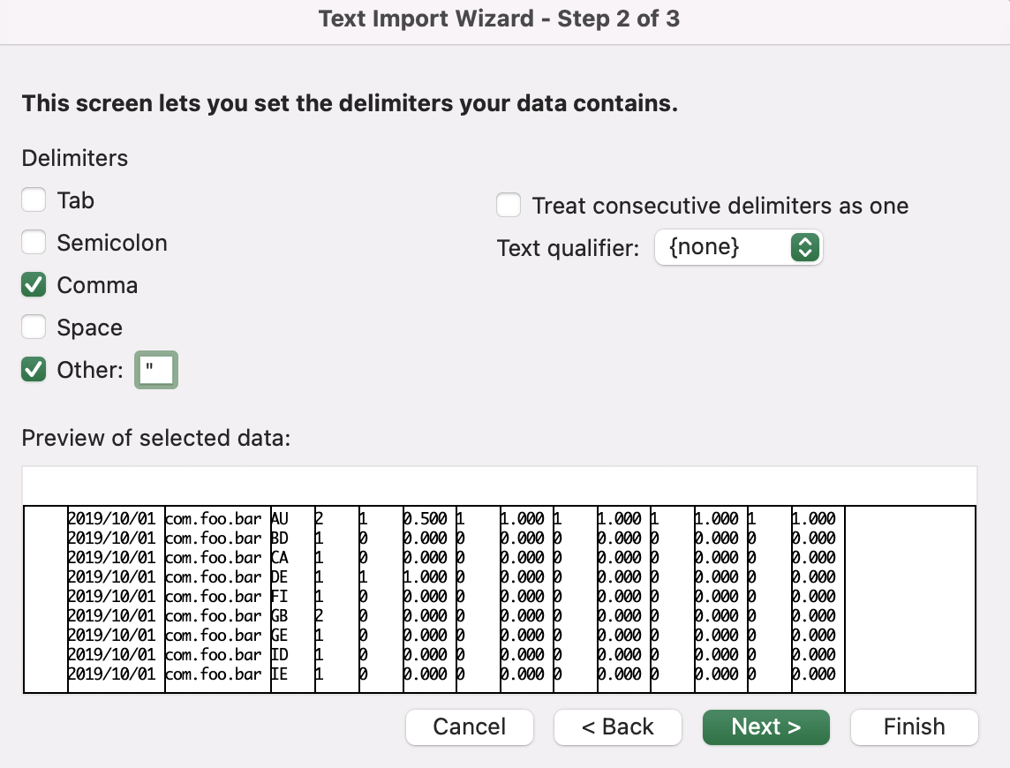
Excel to Convert
Purdue University Global |Foundations of Purdue Global Culture

Slide 27
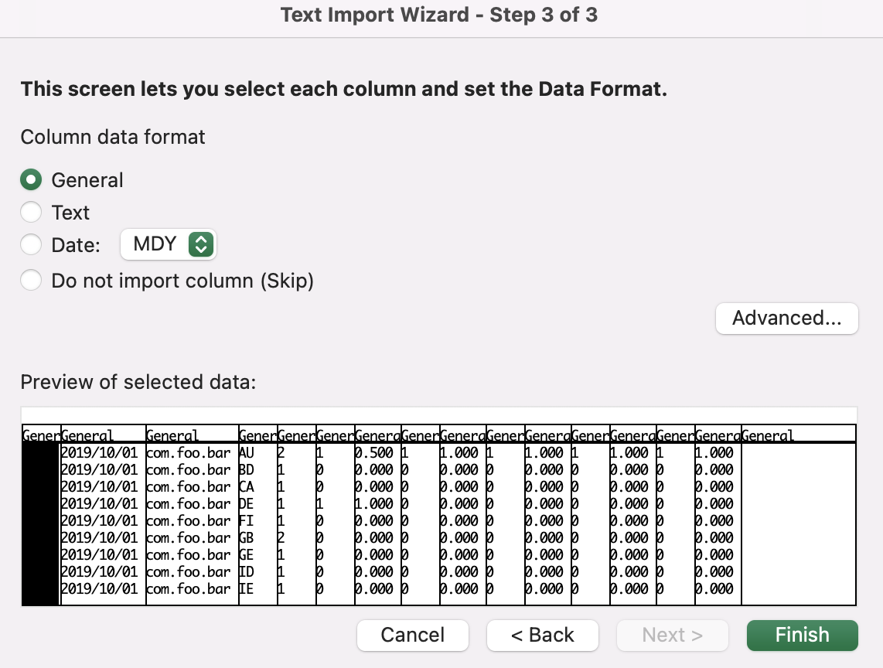
Excel to Convert
Purdue University Global |Foundations of Purdue Global Culture

Slide 28
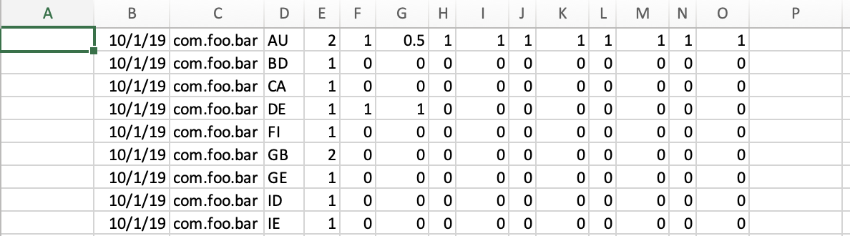
Excel to Convert
Purdue University Global |Foundations of Purdue Global Culture

Slide 29
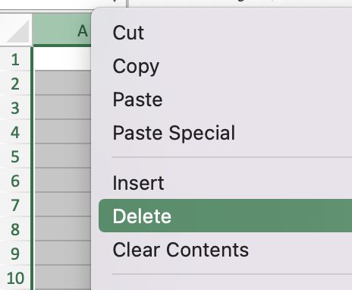
Excel to Convert
Purdue University Global |Foundations of Purdue Global Culture

Slide 30
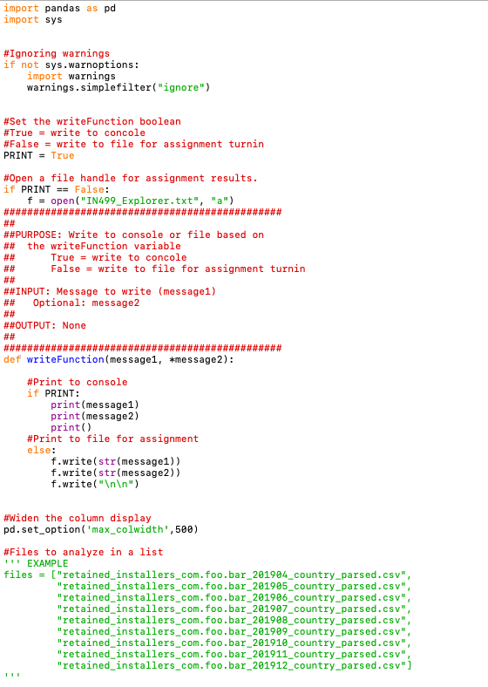
Student Files
Purdue University Global |Foundations of Purdue Global Culture

Slide 31
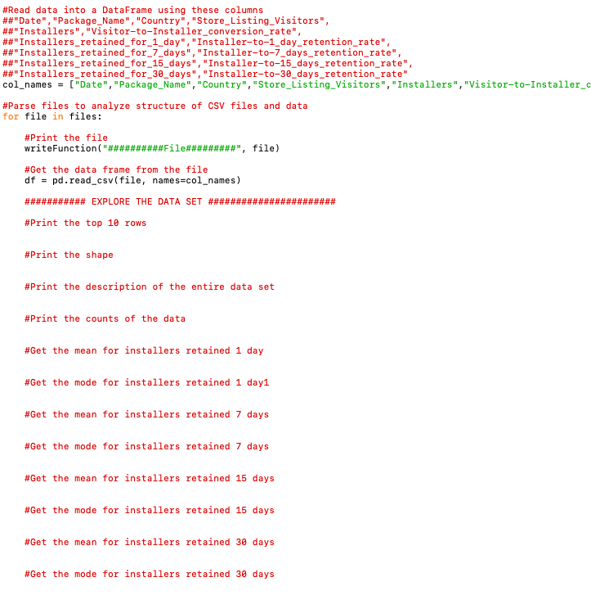
Student Files
Purdue University Global |Foundations of Purdue Global Culture

Slide 32
Merged CSV
Windows:
Put all CSV files into one folder.
Open the command prompt (cmd)and change to the folder directory.
Type copy *.csv merged.csv
MAC/Linux:
Put all CSV files into one folder.
Open a terminal and change to the folder directory.
Cat *.csv > merged.csv
Purdue University Global |Foundations of Purdue Global Culture

Slide 33
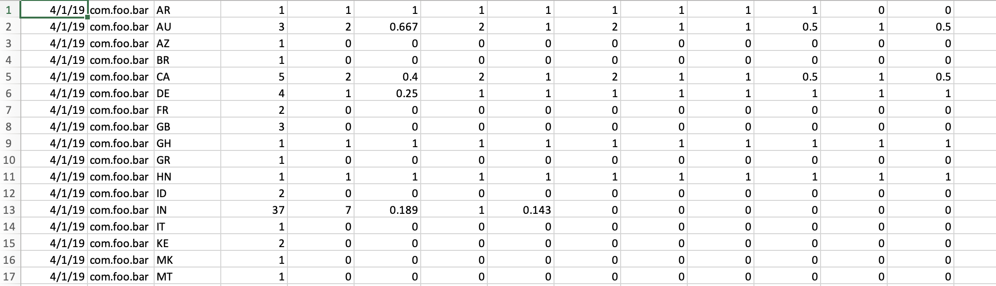
Merged CSV
Purdue University Global |Foundations of Purdue Global Culture

Slide 34
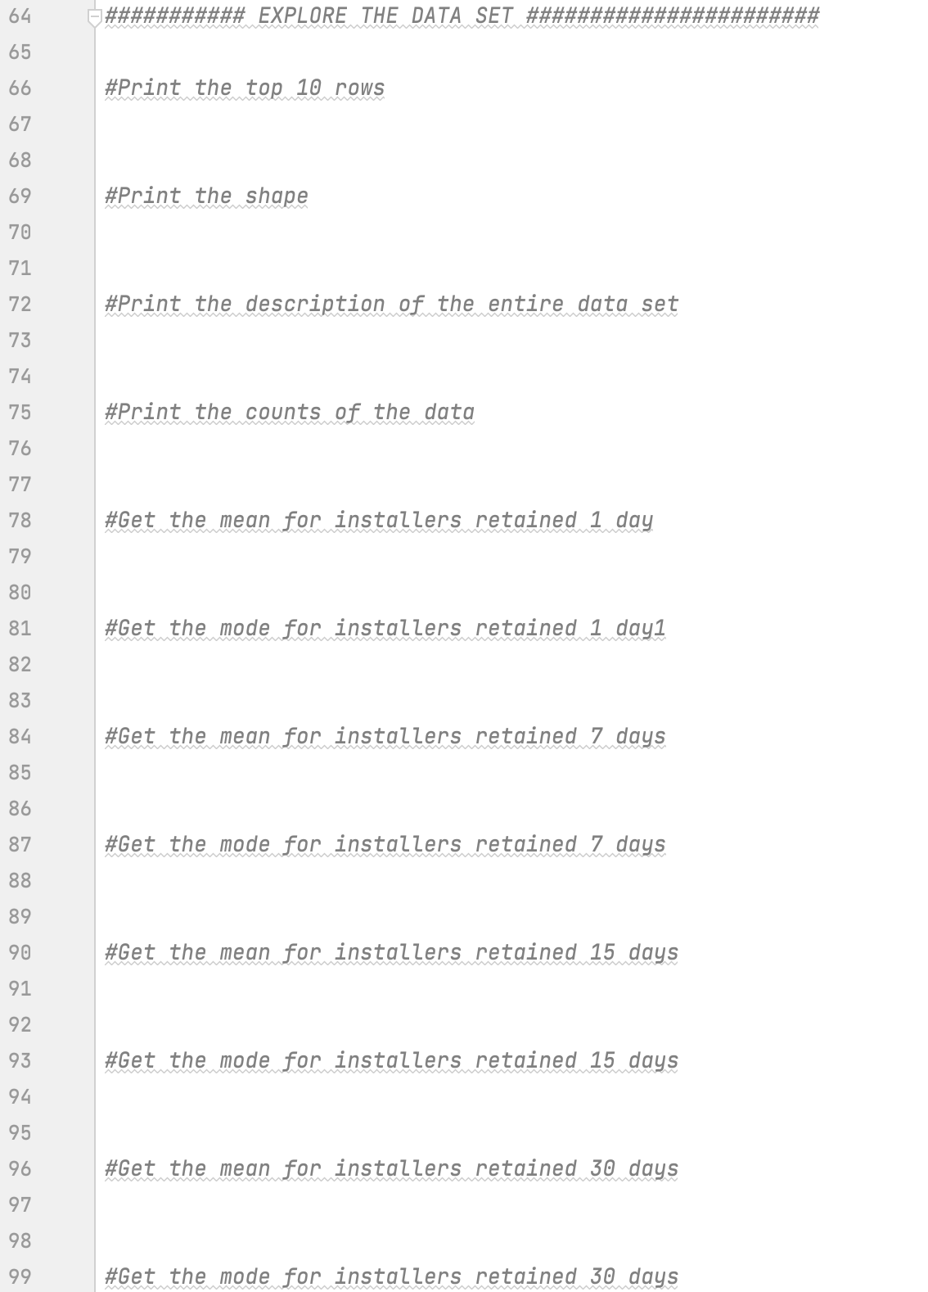
Final Exploratory File
Purdue University Global |Foundations of Purdue Global Culture

Slide 35
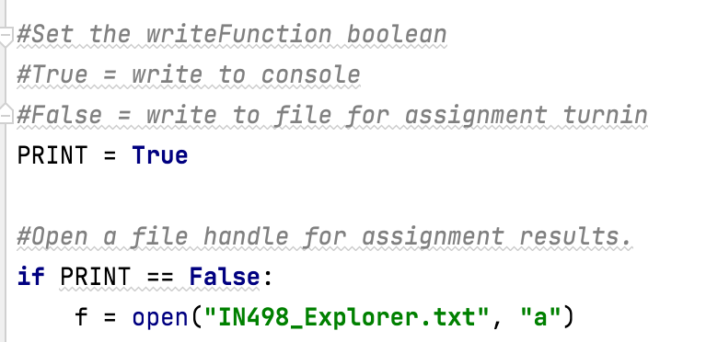
Code and Results Submissions
Please submit the code files and the results for all assignments in the course. I need both for grading.
Purdue University Global |Foundations of Purdue Global Culture

Slide 36
THANK YOU
Thank you for viewing the IN498 Unit 2 presentation. Please contact your instructor at robert.kayl@purdueglobal.edu with any questions.

